Slide 1
GRAPPA Implementation
Jaeeun Lee
2018/01/23

Slide 2
Index
Pseudo code
Result
Background knowledge

Slide 3
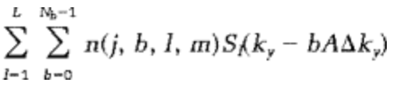

Pseudo code
Ax = b
[ Nx x (Nb*Nc) ] * [ (Nb*Nc) x Nc ] = [ Nx * Nc ]

Slide 4
Pseudo code
Sliding block approach
Using ‘m’
Sum of squares
sqrt(sum(data^2))

Slide 5
Result
# of ACS lines
recon_img = ifftshift(ifft2(ifftshift(recon_data)))
High frequency region handling

Slide 6
Result
# of ACS lines

Slide 7



Result
Edge handling
[Reference] [appending zeros] [without any appending]

Slide 8
Background knowledge
Undersampling
Phase encoding, frequency encoding
Ky, Kx

Slide 9
Background knowledge
Pseudo inverse
AX = B
A^{T}A X = A^{T}Y
(A^{T}A)⁻¹A^{T}A X = (A^{T}A)⁻¹A^{T}Y
X = (A^{T}A)⁻¹A^{T}Y
eigenvalue

Slide 10
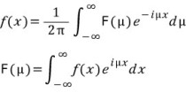
Background knowledge
Fourier Transform
Formula
- DC term

